Slide 1






2025
GROUP 6
MONITORING GYM USAGE
Data Analysis and Forecasting of Student Gym Activity
Presented By
Akshay Gautam Ashwini Jha Ananya Krishnan Renikson Yash Mandip Chhetry

Slide 2



PROJECT OBJECTIVE
Objective:
• Record and analyze student gym visits
• Identify peak hours and trends
• Forecast gym footfall
Problem:
• Crowding and uneven usage
• Manual tracking errors
• Need for data-driven planning
DATA
ANALYSIS
INSIGHTS
FORECAST

Slide 3
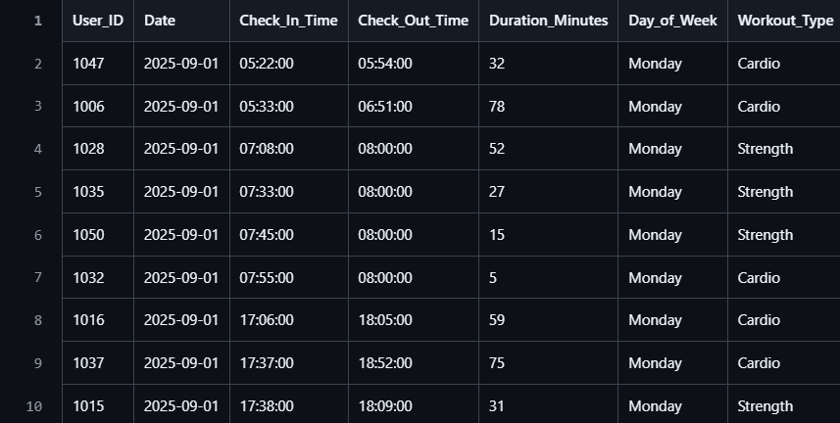

DATA COLLECTION & PREPROCESSING
Data includes anonymized IDs, check-in/out times, durations, and days
Cleaned and structured timestamps
Derived features: day, hour, duration
Anonymized records for privacy

Slide 4
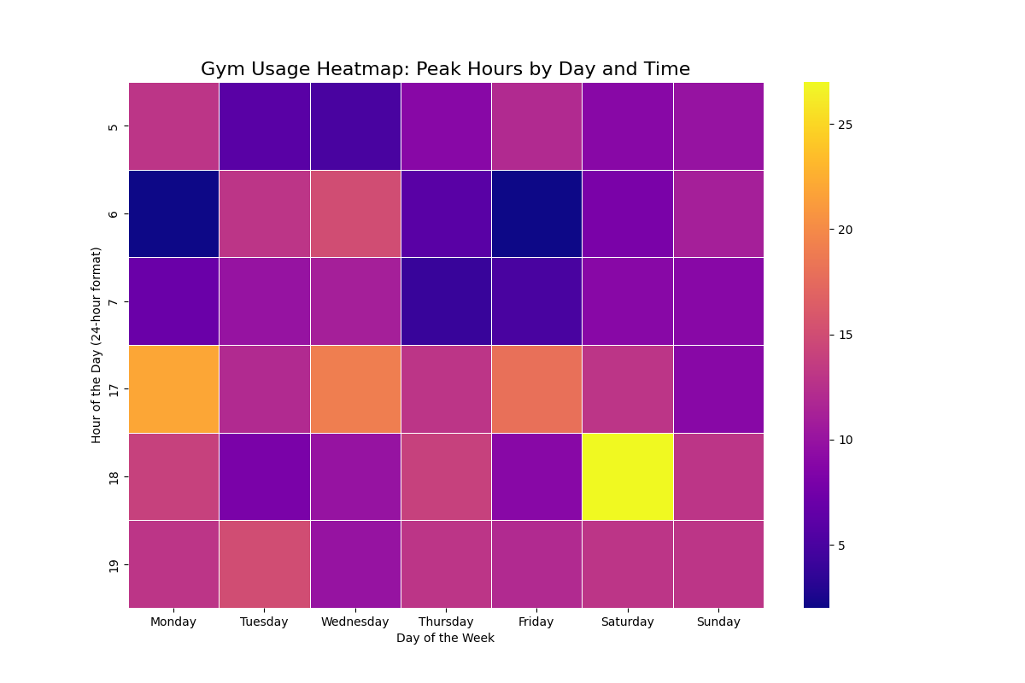
ANALYSIS & MODELS
Exploratory Data Analysis (EDA): Histograms, heatmaps
Clustering (K-Means): Regular, Heavy, Occasional users
Time-Series Forecasting (Prophet): Predicted daily gym footfall

Slide 5
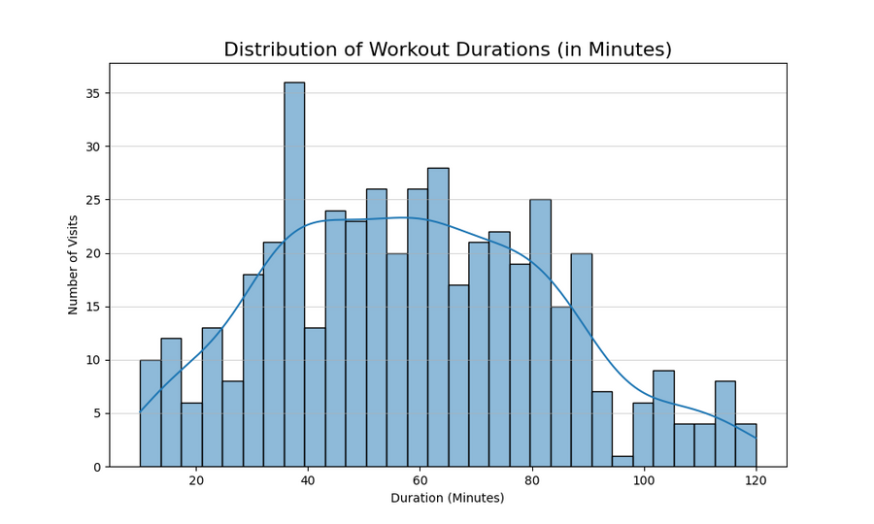
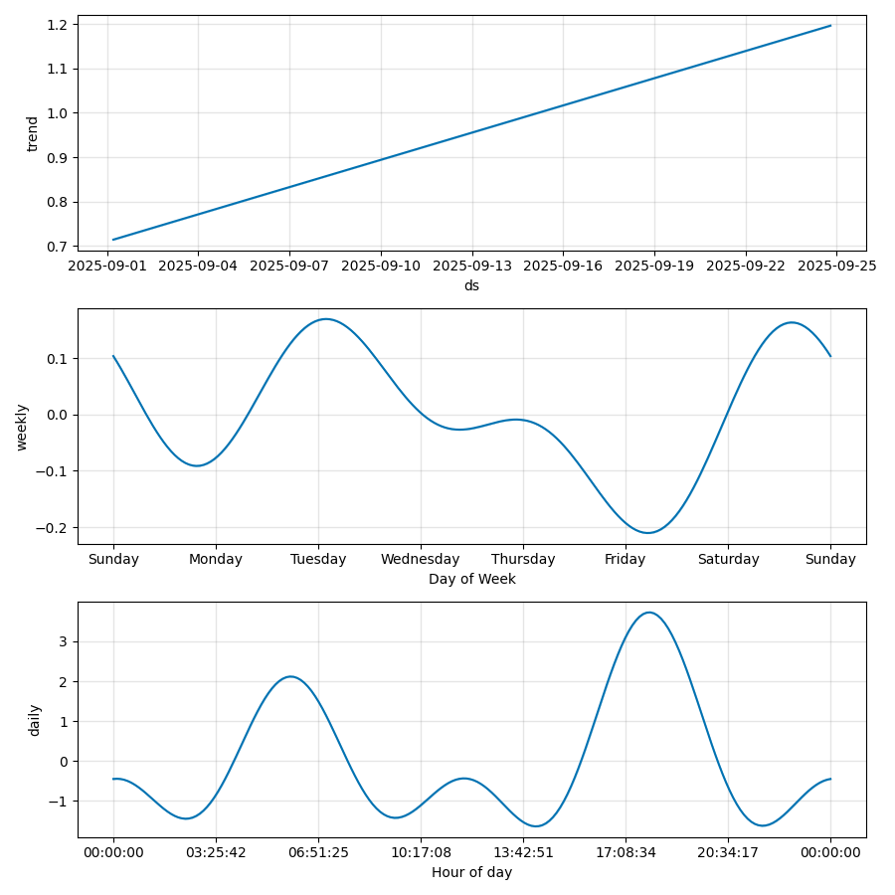
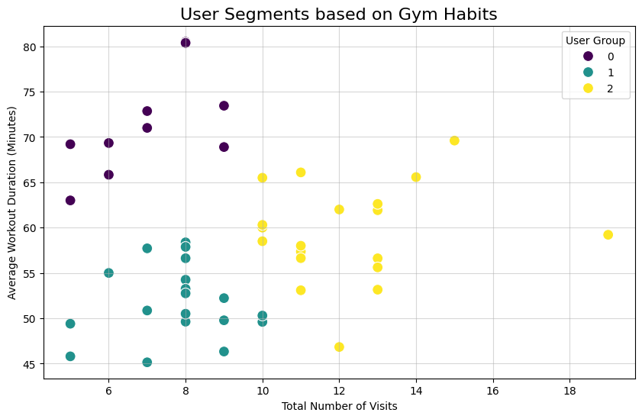

Slide 6
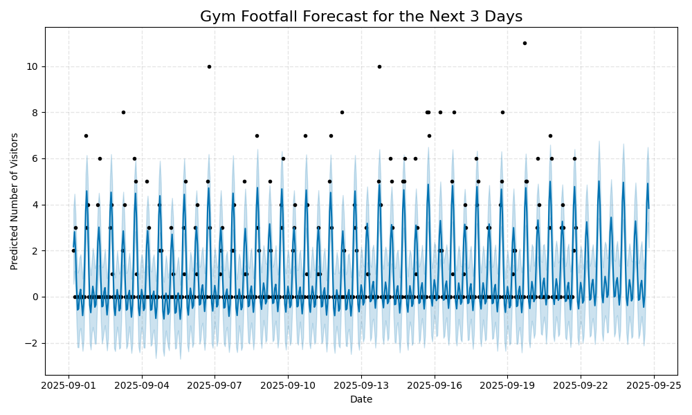
RESULTS & INSIGHTS
Peak hours: Evenings (around 6 PM)
Average workout duration: ~60 mins
Clear weekly usage pattern
Forecast accuracy (MAE, MAPE)
Clustering quality via Silhouette Score

Slide 7
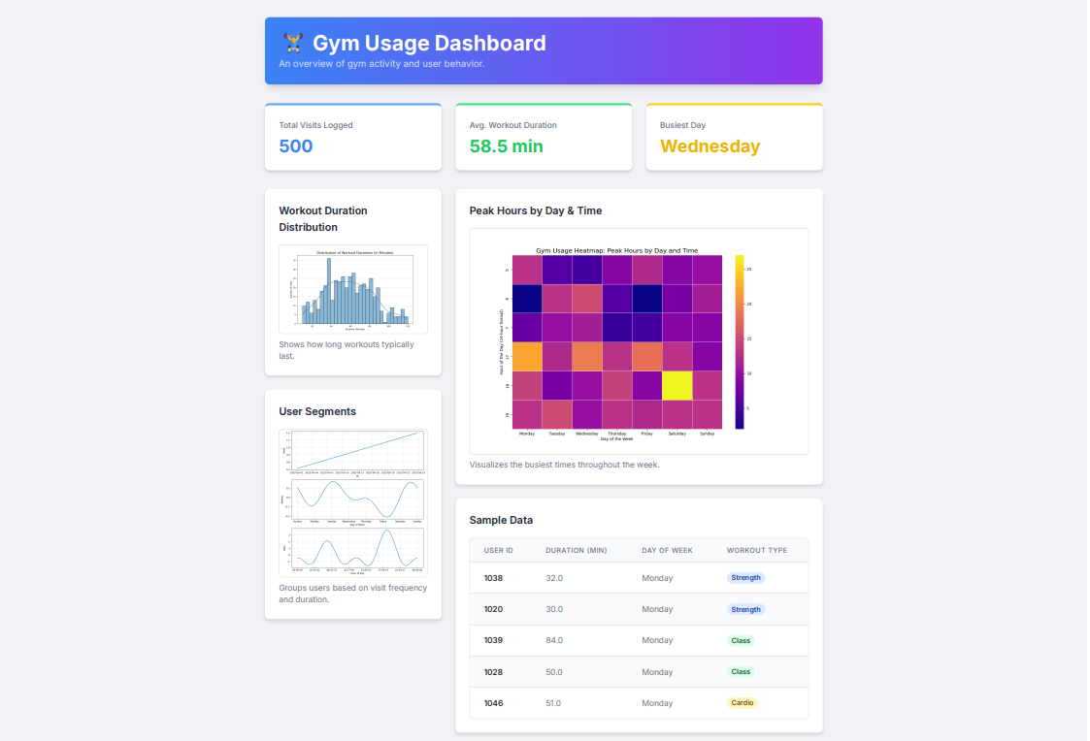
DASHBOARD

Slide 8


CONCLUSION & FUTURE WORK
Data analytics enhances gym management
Enables better resource planning & scheduling
Future enhancements:
Add IoT-based real-time tracking
Include workout-type data
Deploy interactive dashboards

Slide 9

THANK YOU FOR YOUR ATTENTION

